Slide 1


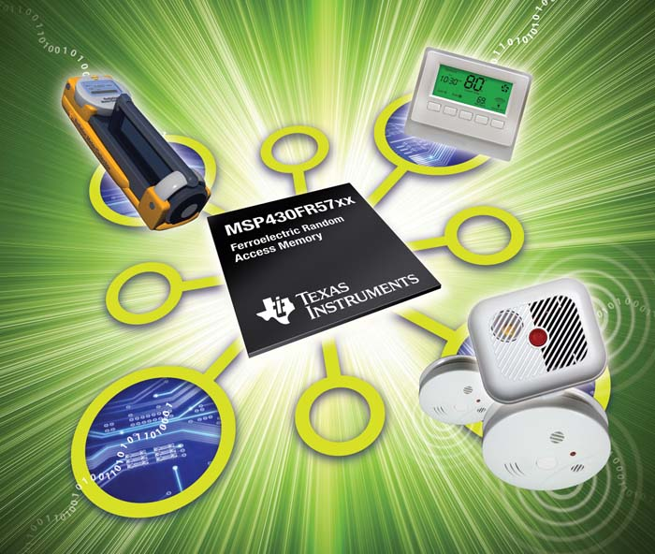
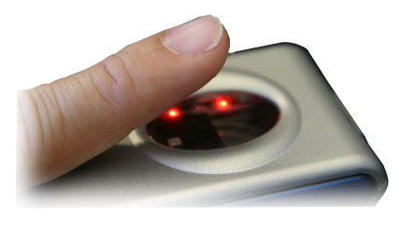
Make the world smarter with industry’s first
ultra-low-power FRAM microcontroller from TI
Unified
Memory = unmatched
flexibility
Unified
Memory = unmatched
flexibility
Ultra-low-power writing
Ultra-low-power writing
Virtually unlimited write endurance
Virtually unlimited write endurance
Instant on/off with memory
retention
Instant on/off with memory
retention
MSP430 FRAM Microcontrollers
2011 Tech Day

Slide 2
Agenda
FRAM Intrinsic Technology Attributes
FRAM as an Embedded Memory
Understanding how FRAM Works
The MSP430FR57xx family
Application Examples using FRAM
Resources
Summary

Slide 3


FRAM – Technology Attributes
Non-Volatile – retains data without power
Fast Write / Update – RAM like performance. Up to ~ 50ns/byte access times today (> 1000x faster than Flash/EEPROM)
Low Power - Needs 1.5V to write compared to > 10-14V for Flash/EEPROM → no charge pump
Superior Data Reliability - ‘Write Guarantee’ in case of power loss and > 100 Trillion read/write cycles
Photo: forums.wow-europe.com
Automotive F-RAM Memory

Slide 4
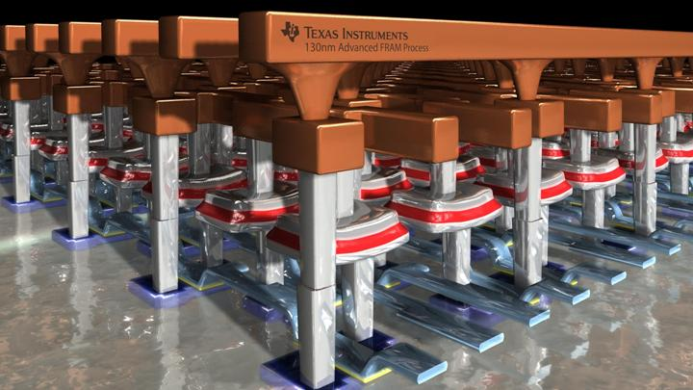
FRAM: Proven, Reliable
Endurance
  Proven data retention
  to 10 years @ 85°C
Less vulnerable to attacks
  Fast access/write times
Radiation Resistance
  Terrestrial Soft Error Rate (SER) is below detection limits
Immune to Magnetic Fields
  FRAM does not contain iron!
www.ti.com/fram
For more info on
TI’s FRAM technology

Slide 5
All-in-one: FRAM MCU delivers max benefits
 | FRAM | SRAM | EEPROM | Flash
Non-volatile Retains data without power | ✓ |  | ✓ | ✓
Write speeds | ✓ | ✓ | ✓
Average active Power [µA/MHz] | ✓ | ✓
Write endurance | ✓ | ✓
Dynamic Bit-wise programmable | ✓ | ✓
Unified memory Flexible code and data partitioning | ✓
Yes
No
Yes
Yes
10ms
<10ms
2secs
1 sec
110
<60
50mA+
260
100
Trillion+
Unlimited
100,000
10,000
Yes
Yes
No
No
Yes
No
No
No
Data is representative of embedded memory performance within device
Notes:
5

Slide 6
Unified memory: Another dimension of freedom for software developers
Before FRAM
With FRAM
Multiple device variants may be required
One device supporting multiple options “slide the bar as needed”
2kB
SRAM
16kB Universal FRAM
16kB Flash (Program)
Often an
additional
chip
is needed
1kB
EEPROM
2kB
SRAM
Data vs. program memory
partitioned as needed
14kB Flash
  Easier, simpler inventory management
  Lower cost of issuance / ownership
    Faster time to market for memory modifications
5kB
SRAM
24kB Flash
To get more SRAM you may have
to buy 5x the needed FLASH ROM
Notes:
6

Slide 7
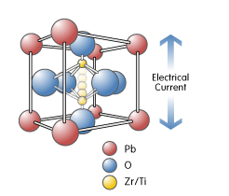
Understanding FRAM Technology
  Is like DRAM; except data stored in crystal state, not charge
    Read/write access and cycle times similar to DRAM
  Is a Random Access Memory - Each bit read/written individually
  Features a simple single step write process – no separate erase then write cycle (unlike Flash)
Photo: Ramtron Corporation
PZT Crystal Structure - Crystal Polarization Change

Slide 8




Understanding FRAM Technology
Programming Data to FRAM
WRITE: Apply voltage to plate line (write ‘0’) or bit line (write ‘1’)
Plate line
Large Induced
Charge (Q)
Bit line
Reading Data from FRAM
READ: Apply a voltage to the plate line, sense the induced charge on the bit line
Plate line
No dipole flip
Small Induced
Charge (Q)
Ferroelectric
Capacitor
Dipole
Flip
Bit line
Sm Q = “0” bit
Lg Q = “1” bit

Slide 9
Industry’s first ultra-low-power FRAM MCU
FRAM
16, 8 and 4 kB options
MSP430FR57xx Microcontroller
Core
Up to 24 MHz
Active power 100 µA/MHz avg.
@ 8MHz
16-bit
RISC
MCU
Memory
Power & Clocking
16kB / 8kB / 4kB FRAM
Power on Reset
Brownout Reset
Low Power Vreg (1.5V)
XT1, VLO
DCO
Real-time Clock
Debug
Real-time JTAG
Embedded Emulation
Boot Strap Loader
Peripherals
Timers
32 x 32 Multiplier
Watch Dog Timer
Integration
DMA (3ch)
Timer0_A3
High precision analog
Up to 5 timers
UART/IrDA/SPI/I²C
CRC16
Timer1_B3
Serial Interface
Timer2_A3
Universal Serial Comm. Interfaces
Timer3_B3
Starting at $1.20 @ 10K
Ch A: 2 UARTor IrDA or SPI
Ch B: I2C or SPI
Timer4_B3
Analog
Ports
Comparator / REF
Up to 3 1x8 + 1 1x3 I/O Ports w/ interrupt/ wake-up
ADC10 (up to 12ch)
Notes:
DCO with 6 frequencies [5,16], [6, 20], [8, 24]Mhz
eUSCI : supports multiple slaves
Comp_D:
5 imers
4 ports with interrupt wakeup
MPU

Slide 10
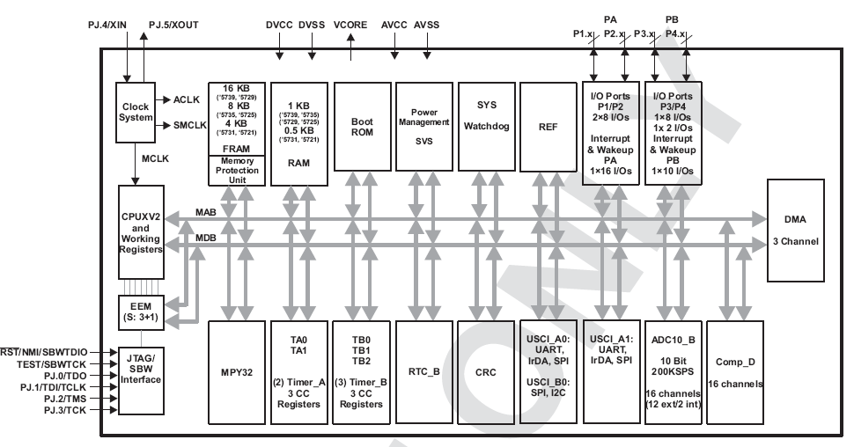
MSP430FR5739 Block Diagram

Slide 11
FR57xx and the Cache
Built-in 2 way 4-word cache; transparent to the user
Cache helps:
  Increase endurance specifically for frequently accessed system parameters e.g. SP, PC, short loops (JMP$)
  Lower power by executing from SRAM
  Increase throughput overcoming the 8MHz limit set for FRAM accesses

Slide 12
FRAM = Ultra-fast Writes
RAM-like performance
  FRAM Technology: Read/write times ~50ns/byte
  FR5739: 12.5µs/byte [8MHz limitation]
The read cycle includes time taken to read and refresh the cell
No pre-erase required for writes
No additional power is needed for FRAM writes i.e. no charge pump
A one byte flash write takes up to 85µs + prep time for erase*
The FR5739 FRAM IP is limited to 8MHz access to FRAM but will increase in the future
From the F5438A D/s segment erase time (512 bytes) t_{erase} = 23ms

Slide 13
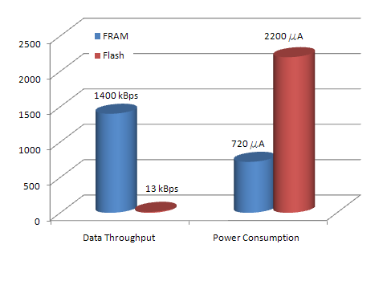
FRAM = Ultra-fast Writes
Use Case Example: MSP430F2274 Vs MSP430FR5739
Both devices use System clock = 8MHz
Maximum Speed FRAM = 1.5Mbps [100x faster]
Maximum Speed Flash = 12kBps
Notes:
13
Think about any data logging application and the impact that this speed can bring you.
A customer example was one where the needed to change the firmware of the slave 430 on-the-fly to enable it to perform different actions as decided by the host.
Previously unthinkable, with FRAM possible

Slide 14
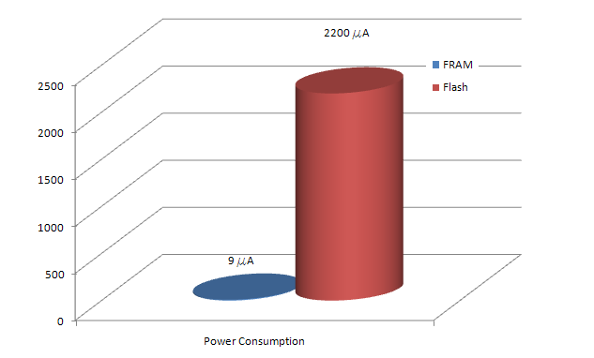
FRAM = Low active write duty cycle
Use Case Example: MSP430F2274 Vs MSP430FR5739
Both devices write to NV memory @ 12kBps
FRAM remains in standby for 99% of the time
Power savings: >200x of flash
Notes:
14
Applications:
There is a definite crossover point where if the Flash writes take place once a day or once a minute – the power savings from FRAM are averaged out.
In this case Flash gives better standby numbers.
But for apps that spend >50% time writing to NV memory – FRAM makes a huge improvement

Slide 15
FRAM = Ultra-low Power
Use Case Example: MSP430F2274 Vs MSP430FR5739
Average power FRAM = 720µA @ 1.5Mbps
Average power Flash = 2200µA @ 12kBps
100 times faster in half the power
Enables more unique energy sources
FRAM = Non-blocking writes
  CPU is not held
  Interrupts allowed
Notes:
15
Applications:
Over the air updates in FRAM Vs Flash
Customer#1 who required non-blocking writes 400KHz streaming I2C
Customer#2 firmware update – could not be unresponsive to interrupts
Flash write disadvantages:
Flash controller is on all the time
CPU is held during the flash write
No interrupts during flash write!!
Low energy applications powered off a super cap cannot support the high peak current of flash erase

Slide 16
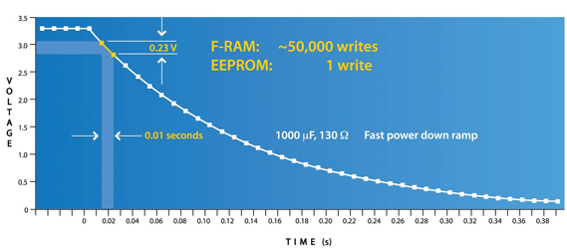
FRAM = Increased flexibility
Use Case Example: EEPROM Vs MSP430FR5739
Many systems require a backup procedure on power fail
FRAM IP has built-in circuitry to complete the current 4 word write
  Supported by internal FRAM LDO & cap
In-system backup is an order of magnitude faster with FRAM
Write comparison during power fail events⁺
⁺ Source: EE Times Europe, An Engineer’s Guide to FRAM by Duncan Bennett
Notes:
16
Applications:
E-metering application – timestamp backup etc

Slide 17
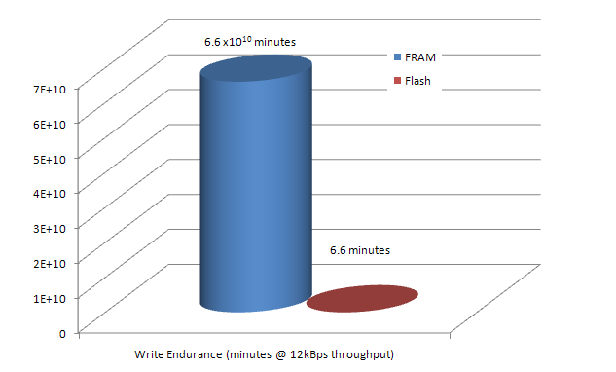
FRAM = High Endurance
Use Case Example: MSP430F2274 Vs MSP430FR5739
FRAM Endurance >= 100 Trillion [10^14]
Flash Endurance < 100,000 [10^5]
Comparison: write to a 512 byte memory block @ a speed of 12kBps
  Flash = 6 minutes
  FRAM = 100+ years!
Notes:
17
Applications:
Unique verticals such as DRM that require very high endurance
Any handheld applications such as BGMs that require multiple flash locations or redundancy to increase endurance because flash cannot perform random writes→ are significantly improved by FRAM

Slide 18
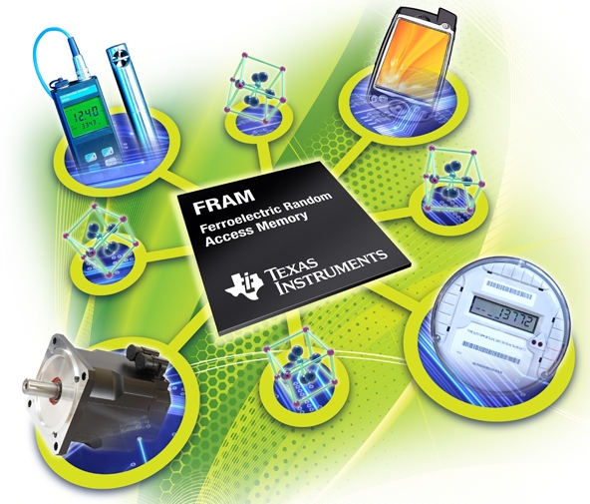
Target Applications
Data logging, remote sensor applications (High Write endurance, Fast writes)
Digital rights management (High Write Endurance – need >10M write cycles)
Battery powered consumer/mobile Electronics (low power)
Energy harvesting, especially Wireless (Low Power & Fast Memory Access, especially Writes)
Battery Backed SRAM Replacement (Non- Volatility, High Write Endurance, Low power, Fast Writes)
Notes:
Here are a few applications that highlight specific application where FRAM can be useful. Some of these applications are from customers who already have buy-ins with TI’s embedded FRAM MCU.
In many cases , using FRAM is seen as an advantage. In some, it is the ONLY technology that will suit an application’s requirements. We can sell FRAM to both spheres.
For example: data logging today obviously uses Flash or some form of EEPROM and this works reliably. Here FRAM brings added value because it can do the same things but with lesser power, faster and the cost is comparable if not cheaper.
However for energy harvesting applications FRAM could be seen as a _requirement_ especially if any kind of memory writes are needed – there is no non-volatile memory technology that is as low power and as fast as FRAM.

Slide 19
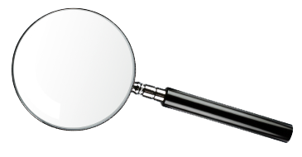
Continuous ultra-low-power data logging
Write Endurance
10,000 cycles
> 100,000,000,000,000 cycles
Trillions
Supports more than 150,000 years of continuous data logging (vs. less than 7 minutes with Flash)
Notes:
19

Slide 20




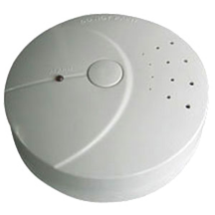
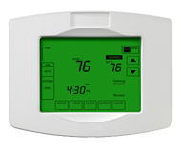





Make it smarter: More sensors. More data.
20
Notes:
20

Slide 21
MSP430FR57xx in the energy plane enables more sensors in new places
2200A
FRAM: Up to 250x less
Current
13kBps Flash Write
1400kBps
FRAM Write
FRAM: More than 100x faster
9A
10 ms
Time
1 sec
Notes:
21

Slide 22
Seismic Monitoring Systems
Needs
Power source
Accurate, fast, robust data recording on board from multiple sensors
Ultra low power operation
  Maximize battery life
  Enable advanced processing on board
Maximize data storage capability
  Increased sensor life
  Reduce maintenance
Battery
Supercap
Solar cell
Power Management
Flash based Microcontrollers
MSP430FR57xx
w/ Integrated FRAM
Radio
Transceiver
MSP430FR57xx delivers
Clock
EEPROM
Instant, robust writes – even on power loss
Ultra low power writes –
100x< Flash/EEPROM
  Save power to enable advanced processing on board within same power budget
  Increase battery life
Virtually unlimited writes
  Reduce BOM (external EEPROM)
  Reduce sensor replacement
Accelero-meter
Humidity / Temp
Other sensors
Sensors

Slide 23
Batteryless Intelligent Energy Harvesting Switch
Needs
Pressure
Vibration
Accurate, fast, robust data recording on status
  Intelligent status processing and transmission
Ultra low power operation
  Enable advanced processing on board → minimum power consumption for MCU
Maximize data storage capability
  Increased device life
  Reduced maintenance
Power source
Supercap
Power Management
Flash based Microcontrollers
MSP430FR57xx
w/ Integrated FRAM
Radio
Transceiver
Clock
MSP430FR57xx delivers
EEPROM
Instant, robust writes – even on power loss
Ultra low power writes –
100x< Flash/EEPROM
  Save power to enable advanced processing & RF transmission on
  board within same power budget
Virtually unlimited writes
  Reduce sensor replacement – lower maintenance cost

Slide 24
SFP+ Optical Network Switch Modules
TOSA
EEPROM
VCSEL Laser Driver
SERDES
TRANSCEIVER
VCSEL
Flash Microcontroller
MSP430FR57xx
w/ Integrated FRAM
ROSA
Transimpedance Amplifier
Limiting AMP
Needs
MSP430FR57xx delivers
Granular, fast memory access
  >100 trillion read/write cycles
  Remove external EEPROM & lower test costs
Reduced material count
Accurate, fast, robust data access
Cost sensitive
Small Footprint

Slide 25


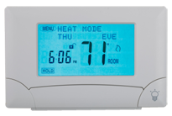
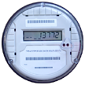
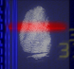
FRAM enables efficient wireless updates
Over the air updates
Challenge
FRAM solution
Consumes up to 1 month battery life
for a single update
Uses < 1/4 day battery life
Home
automation
Block level erase & program
Bit level access
Need redundant (mirror) memory blocks
Write guarantee in case of power loss
Metering
Safety & security

Slide 26

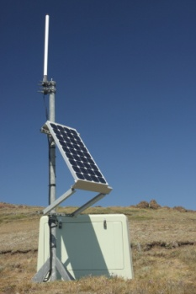




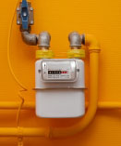

FRAM solves real-world challenges
Sensor Datalogging
Challenge
FRAM solution
Power consumption limits locations, increases maintenance
Energy harvesting enables more sensors
in more locations
Asset
Tracking
Limited data update/
write speed
Continuous and reliable monitoring , storage and RF transmission
Flow meters
Seismic
monitoring
Sports &
Fitness
Selective monitoring
Continuous monitoring
Over-the-air updates
Challenge
FRAM solution
Consume up to 1 month
battery life
Block level erase & program
Need redundant (mirror) memory blocks
Uses less than ¼ day of battery life
Home
automation
Bit level access
Safety &
security
Write guarantee in case of power loss
Metering

Slide 27









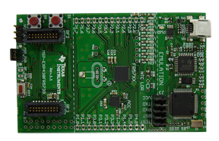



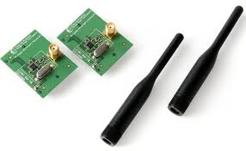
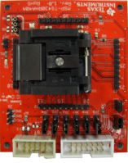
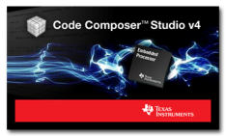
Speed design with tools, software and system solution
System solution
Get started in less than 10 minutes
TI offers the Industry’s broadest RF portfolio
With hardware modules compatible
with the MSP-EXP430FR5739
With RF design tools
With reference designs,
software & complete ecosystem
Making RF connectivity easy & affordable
MSP-EXP430FR5739
Experimenter’s Kit
Preloaded “User Experience” Demo code
On board emulation, LPM measurement,
Accelerometer, 8 LEDs, switch buttons
Connect to other MSP430 boards
and TI wireless portfolio
Price: $29.00
MSP-TS430RHA40A
Development Kit
40-pin ZIF socket target board used
to program and debug the MSP430
in-system through the JTAG interface
Price: $99
<1GHz
Code libraries
IAR-EW430 v5.20.x supporting FRAM devices
CCS v4.2.3 supporting FRAM devices
Comprehensive application and “How to” notes
More info at:
www.ti.com/fram
www.ti.com/fr57wiki
Notes:
27

Slide 28
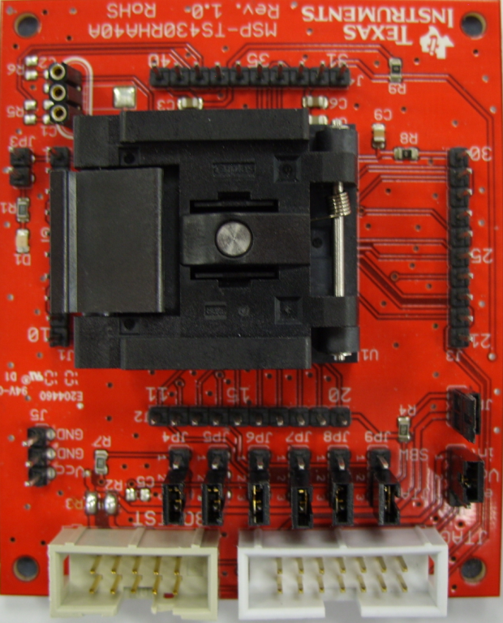
Getting Started with MSP430FR5739
MSP430FR5739 Target Board
Development board with 40-pin RHA socket (MSP-TS430RHA40A)
All pins brought out to pin headers for easy access
Programming via JTAG, Spy-bi-wire or BSL
$99

Slide 29
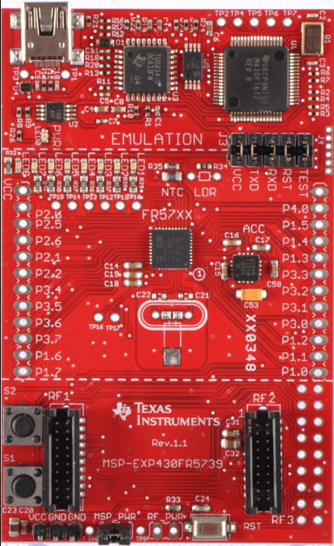
Getting Started with MSP430FR5739
MSP-EXP430FR5739 FRAM Experimenter’s Board
$29
On Board Emulation
Features
  3 axis accelerometer
  NTC Thermister
  8 Display LED’s
  Footprint for additional through-hole LDR sensor
  2 User input Switches
User Experience
  Preloaded with out-of-box demo code
  4 Modes to test FRAM features:
    Mode 1 - Max FRAM write speed
    Mode 2 - Flash write speed emulation
    Mode 3 – FRAM writes using sampled accelerometer data
    Mode 4 – FRAM writes using sampled Thermistor data

Slide 30

Industry’s first ultra-low-power FRAM MCU
More sensors in new places with ultra-low-power memory
Write more than 100x faster using 250x less power
Virtually unlimited write endurance
Non-volatile memory: data retention possible in ALL power modes
Experience unparalleled freedom with unified memory
Easily change memory partitioning in software
Eliminate need for separate EEPROM and battery-backed SRAM
Speed up designs – Tools, software and system solution
Low cost development kits and code compatibility across MSP platform
Industry’s broadest RF technology & tools portfolio
Training and documentation
30
Notes:
30

Slide 31
Backup

